Slide 1

A Primer to Complex Diseases
National Institute of Technology Karnataka, Surathkal
A seminar by
Venkatesh. S (Roll No.:176PH023)
2nd M.Sc. Physics
(As part of seminar course PH893 during Odd Semester, 2018)
Notes:
Intro slide

Slide 2
Questions
What is a Complex disease?
How to study Complex diseases?
What can we aim to study with Complex Networks?

Slide 3
Questions
What is a Complex disease?
How to study Complex diseases?
What can we aim to study with Complex Networks?

Slide 4
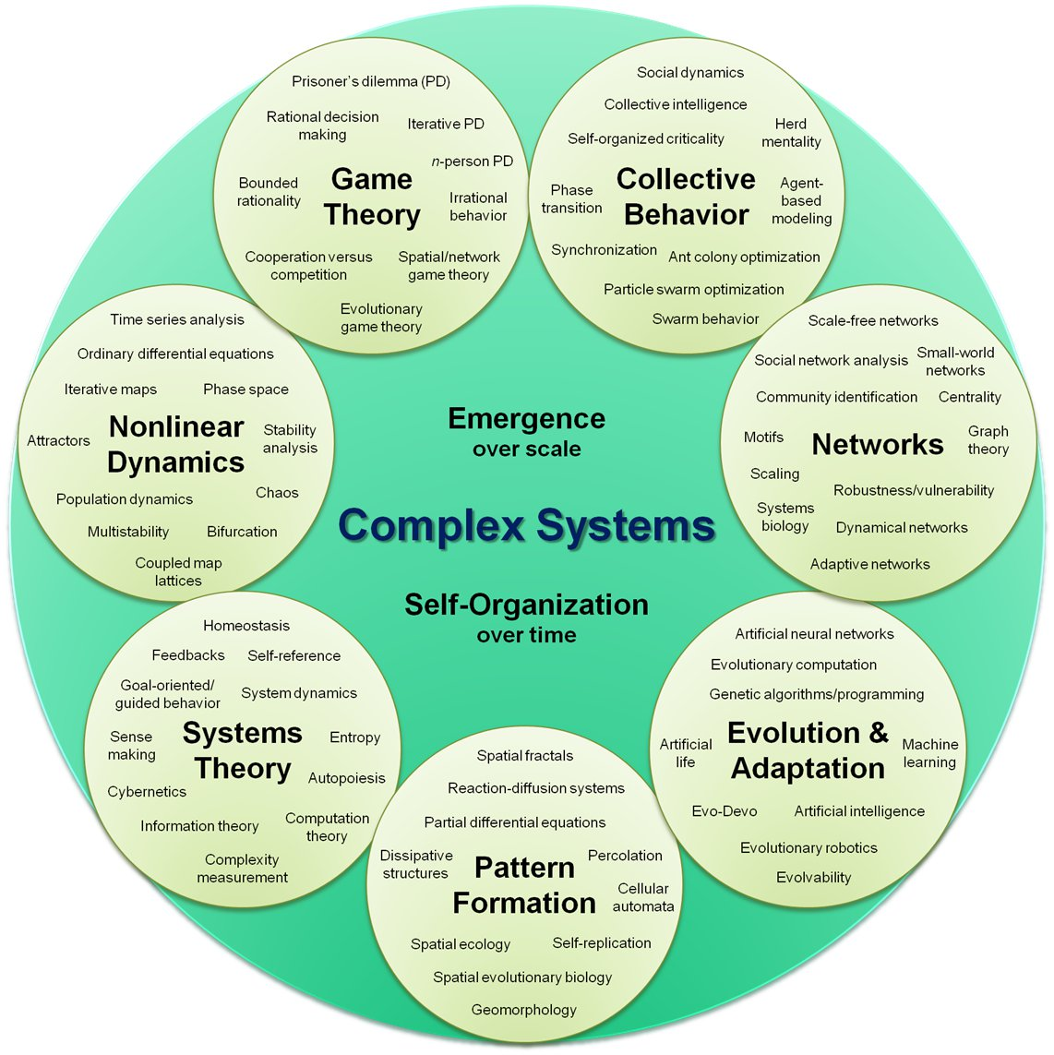
What is a Complex System?
“Complex systems are networks made of a number of components that interact with each other, typically in a nonlinear fashion. Complex systems may arise and evolve through self-organization, such that they are neither completely regular nor completely random, permitting the development of emergent behaviour at macroscopic scales.”^{1*}
*Not a definition. That would be reductionist!
1. Sayama. 2015. Introduction to the Modelling and Analysis of Complex Systems. New York: Open SUNY Textbooks.
Fig 1. Concept map of Complex systems¹

Slide 5
General properties of Complex systems²
They have a large number of agents that can be considered simple.
Like ant colonies
The interactions are non linear
The whole is not the sum of the parts.
They show emergent behaviour.
There is a hierarchical organization.
They are self organizing.
No agent is the leader
They can be modelled as networks.
More on this later
2. Lloyd, Seth. n.d. “Measures of Complexity a Non-Exhaustive List.” Accessed November 2, 2018. http://web.mit.edu/esd.83/www/notebook/Complexity.PDF.

Slide 6
What is a Complex Disease?
“…complex diseases [are those that] arise as a consequence of the combined effect of multiple genetic determinants, which may vary between individuals, and environmental factors and wherein the phenotype cannot be easily predicted from the genotype. This is proposed to be due to the interaction between genes (epistasis), modulation by environmental factors or stochastic processes, or epigenetic changes.”³ They also don’t follow Mendelian inheritance.
Examples include : Alzheimer’s disease, Asthma, Parkinson’s disease
Caveat Emptor! Disease classification is complicated…
3. Furlong, Laura I. 2013. “Human Diseases through the Lens of Network Biology.” Trends in Genetics 29 (3): 150–59.

Slide 7
Complex diseases as Complex Systems
A Complex disease is a type of complex system.
Agents = Thousands of Genes or Proteins or Metabolites
These genes or proteins interact chemically or physically, non linearly.
From the Central Dogma of Molecular Biology⁴, mutations in the DNA sequence affect the genes which affects RNA which in turn affects the protein which in turn causes a phenotype. Thus there is emergent behaviour(Hierarchical structure).
There is no one central gene that causes the disease. It is the result of interactions between multiple genes. Thus it is self organizing.
4. Griffiths AJF, Miller JH, Suzuki DT, et al. An Introduction to Genetic Analysis. 7th edition. New York: W. H. Freeman; 2000. Gene-protein relations.

Slide 8
Questions
What is a Complex disease? A type of Complex system with thousands of genes/proteins/metabolites interacting non linearly causing an undesirable phenotype.
How to study Complex diseases?
What can we aim to study with Complex Networks?
Any questions at this point?
Please, feel free to ask!

Slide 9
Questions
What is a Complex disease? A type of Complex system with thousands of genes/proteins/metabolites interacting non linearly causing an undesirable phenotype.
How to study Complex diseases?
What can we aim to study with Complex Networks?

Slide 10
A general statement of the problem
We need to study the structure of the interaction between thousands of genes/proteins/metabolites.
It is logical to assume that these interactions should not be random. Nature should have OPTIMIZED for something. For instance, for robustness or minimal number of agents in a particular reaction.
So, the general problem – How can several agents undergo interactions to get structured in a way to OPTIMIZE for something?
Have we encountered such a problem in other contexts? If yes, then we can copy the technique used to solve that problem here also…
The answer is yes!

Slide 11
A Physics problem – The Ising model⁵
With the Ising model we try to model the magnetic behaviour of materials.
In most textbooks we make an approximation and say that only neighbouring Ising spins interact⁶. But instead say that there is some probability for any two spins to interact.
Now we ask, how do thousands of such spins interact to OPTIMIZE their energies to show ferromagnetism below Curie temperature and paramagnetism above it? Also how do they behave near the Curie temperature?
This looks just like our problem with Complex diseases! Here is some basic idea on how Physicists approach the above Ising spin model problem.
5. Hartmann, Alexander K. and Martin Weigt . Phase transitions in combinatorial optimization problems, Wiley-VCH, Weinheim, 2005.
6. Schroeder, Daniel. V. An Introduction to Thermal Physics, Addison-Wesley Publishing Company, San Francisco, 1999.

Slide 12
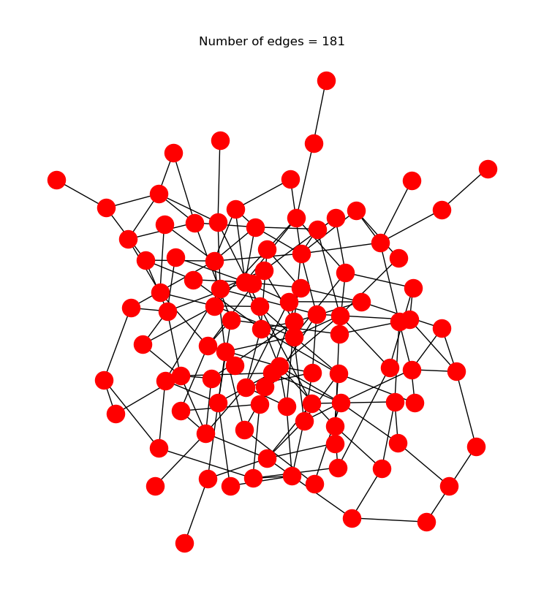
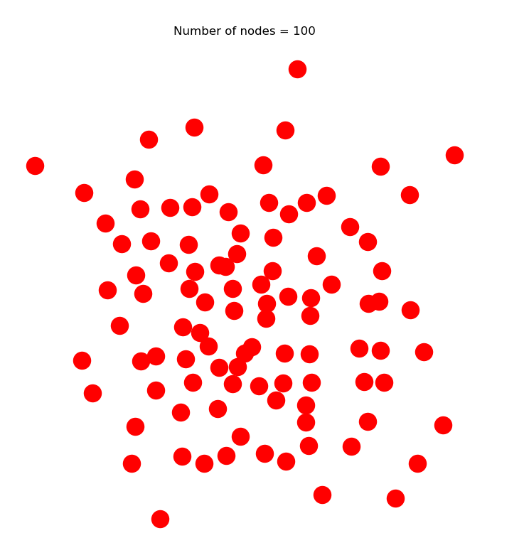
Ising spin model with quenched disorder
WE ENDED UP USING GRAPHS/NETWORKS!

Slide 13
Combinatorial OPTIMIZATION requires Graphs
Basically, in both the Complex Diseases problem and Ising spin problem we were trying to do ‘Combinatorial Optimization’.
In Combinatorial Optimization, we need to optimize a multidimensional system over several distinct variables.
As we saw, in the Ising spin problem, we naturally ended up using Graphs aka Networks. This seems to be the case in many other Physics problems where we end up doing some kind of Combinatorial Optimization. For instance, the Lieb’s theorem of the Hubbard model, Feynman Graphs in QFT etc. all use Graph Theory.⁷
So, from our knowledge of Combinatorial Optimization in Physics we should decide to study Complex Diseases also with Graphs/Networks called ‘Complex Networks’.
7. Estrada, Ernesto. 2013. “Graph and Network Theory in Physics. A Short Introduction.” http://arxiv.org/abs/1302.4378.

Slide 14
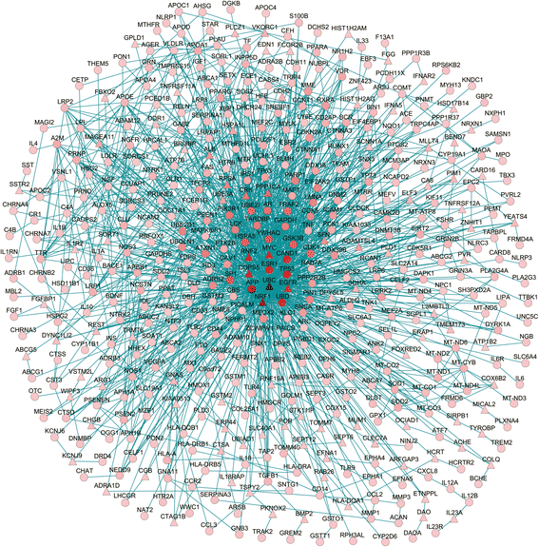
Here is a complex network of Alzheimer’s Disease⁸
Nodes = 496 and Edges = 1521
List of proteins was made by a literature survey of 5298 reports retrieved from PubMed with the search string, ‘(Alzheimer’s Disease [MeSH]) AND (Poly- morphism [MeSH] OR Genotype [MeSH] OR Alleles [MeSH]) NOT (Neoplasms [MeSH])’
Used Steiner Minimal Tree Algorithm from GenRev package
Instead of doing it this way, one could identify all the proteins in the lab and then make a network (or retrieve the list from a lab’s database that did it)
8. Hu, Yan-Shi, Juncai Xin, Ying Hu, Lei Zhang, and Ju Wang. 2017. “Analyzing the Genes Related to Alzheimer’s Disease via a Network and Pathway-Based Approach.” Alzheimer’s Research & Therapy 9 (1): 29.

Slide 15
Questions
What is a Complex disease? A type of Complex system with thousands of genes/proteins/metabolites interacting non linearly causing an undesirable phenotype.
How to study Complex diseases? With Networks, since Combinatorial Optimization problems are modelled with them.
What can we aim to study with Complex Networks?
Any questions at this point?
Please, feel free to ask!

Slide 16
Questions
What is a Complex disease? A type of Complex system with thousands of genes/proteins/metabolites interacting non linearly causing an undesirable phenotype.
How to study Complex diseases? With Networks, since Combinatorial Optimization problems are modelled with them.
What can we aim to study with Complex Networks?

Slide 17
Find measures that matter⁹
There are a lot of measures usually done with Complex Networks.
Some of them include:
Degree
Clustering Coefficient
Betweenness Centrality etc.
We need to identify which of these actually matter.
Note that none of the known measures may end up mattering! We may have to cook up a new measure of our own.
9. Newman, M. E. J. 2003. “The Structure and Function of Complex Networks.” SIAM Review 45 (2): 167–256.

Slide 18
Understand Network Topology⁹
As mentioned before, we hope that nature would not have come up with just random interactions. There should be some underlying structure behind what looks like a mess to the human eye.
So far it is believed that real world networks have Scale Free Degree distribution. This has been explained by ‘Preferential attachment’ models¹⁰.
But there is evidence to believe that PPIs don’t follow this distribution¹¹.
The problem of ‘Graph Isomorphism’ comes into play when trying to study large scale structure with random graph models.
“All happy families are alike; each unhappy family is unhappy in its own way.” – Leo Tolstoy (Statisticians call it ‘The Anna Karenina principle’.)
10. Barabasi, and Albert. 1999. “Emergence of Scaling in Random Networks.” Science (New York, N.Y.) 286 (5439): 509–12.
11. Pržulj, Nataša. 2007. “Biological Network Comparison Using Graphlet Degree Distribution.” Bioinformatics 23 (2): 177–83.

Slide 19
Learn Dynamics and other behaviour⁹
We can study how the network behaves overtime.
One could study how the networks respond to external stimuli
Maybe we can try and answer the ‘nature vs nurture’ question?
Robustness, Adaptiveness etc. can also be studied.

Slide 20
Questions
What is a Complex disease? A type of Complex system with thousands of genes/proteins/metabolites interacting non linearly causing an undesirable phenotype.
How to study Complex diseases? With Networks, since Combinatorial Optimization problems are modelled with them.
What can we aim to study with Complex Networks? We can find measures that matter; understand large scale structure and learn about dynamics and other behaviour.

Slide 21
Questions & Answers
What is a Complex disease? A type of Complex system with thousands of genes/proteins/metabolites interacting non linearly causing an undesirable phenotypes.
How to study Complex diseases? With Networks, since Combinatorial Optimization problems are modelled with them.
What can we aim to study with Complex Networks? We can find measures that matter; understand large scale structure and learn about dynamics and other behaviour.

Slide 22
THANK YOU!
Any questions?
Please, feel free to ask!

Slide 23
References
Sayama, Hiroki. 2015. Introduction to the Modelling and Analysis of Complex Systems. New York: Open SUNY Textbooks.
Lloyd, Seth. n.d. “Measures of Complexity a Non-Exhaustive List.” Accessed November 2, 2018. http://web.mit.edu/esd.83/www/notebook/Complexity.PDF
Furlong, Laura I. 2013. “Human Diseases through the Lens of Network Biology.” Trends in Genetics 29 (3): 150–59.
Griffiths AJF, Miller JH, Suzuki DT, et al. An Introduction to Genetic Analysis. 7th edition. New York: W. H. Freeman; 2000. Gene-protein relations.
Hartmann, Alexander K. and Martin Weigt . Phase transitions in combinatorial optimization problems, Wiley-VCH, Weinheim, 2005.
Schroeder, Daniel. V. An Introduction to Thermal Physics, Addison-Wesley Publishing Company, San Francisco, 1999.
Estrada, Ernesto. 2013. “Graph and Network Theory in Physics. A Short Introduction.” http://arxiv.org/abs/1302.4378.
Hu, Yan-Shi, Juncai Xin, Ying Hu, Lei Zhang, and Ju Wang. 2017. “Analyzing the Genes Related to Alzheimer’s Disease via a Network and Pathway-Based Approach.” Alzheimer’s Research & Therapy 9 (1): 29.
Newman, M. E. J. 2003. “The Structure and Function of Complex Networks.” SIAM Review 45 (2): 167–256.
Barabasi, and Albert. 1999. “Emergence of Scaling in Random Networks.” Science (New York, N.Y.) 286 (5439): 509–12.
Pržulj, Nataša. 2007. “Biological Network Comparison Using Graphlet Degree Distribution.” Bioinformatics 23 (2): 177–83.

